Slide 1
[Vietnam]: A warm welcome to the KRX, and farewell to partying like it’s 1999.
VNINDEX: 1226 (-0.2% WoW / -3.2% YTD / +0.8% YoY). Nothing happened, as expected, on the markets -- Vietnam was busy gearing up for the 50th Reunification Day on April 30, the start of a five-day weekend.
KRX trading system launch today (May 5)! Hard to imagine after a decade’s wait, but the launch seems a near-certainty as I write this (April 29) now that the exchange has announced the “new” system’s launch. Don’t expect anything too exciting on Day 1. It’s true that the system provides a platform for substantial market liberalization, but this will also require regulatory reform that is likely to be a gradual process, not a Big Bang. Still, it’s a big step!
Capital flight – Don’t blame the evil foreigners. GSO reports net E&O of US$29bn last year, more than offsetting the $20.2bn in 2024 FDI disbursals and represents c.6% of GDP – on this measure, we’re very probably the global champs! Unexplained outflows were just US$17bn in 2023, but that was the 3rd largest in absolute terms (only China and Nigeria were higher) and the highest globally relative to GDP at 4.6% -- it only got worse in 2024.
PNJ – Nothing glitters when there’s no gold to buy, so watch for any news on Decree 24 (which regulates gold sourcing) as a possible catalyst to reverse the stock’s relentless slide. Di reiterates BUY but cuts her target price by 14% to VND108k (implying +53% upside). PNJ now offers 2.2% FOL room -- a historic high.
Results: DGC’s selloff is overdone – and 1Q25 sales (+18% YoY) and PAT (+19% YoY) look like they will beat full-year guidance / our forecasts. We see DGC as a play on ex-China semiconductor demand – BUY!
Consumer: Increased confidence for MWG & FRT after the AGMs / results last week. ICT retail is not dead yet.
Banks: MBB & VPB delivered lackluster 1Q25 earnings and 40% / 50% dividend cuts for 2025E.
VIN-downgrades after the magic rallies of 40% for VRE and 55% for VHM. Talk to Tam on today’s call.

Slide 2
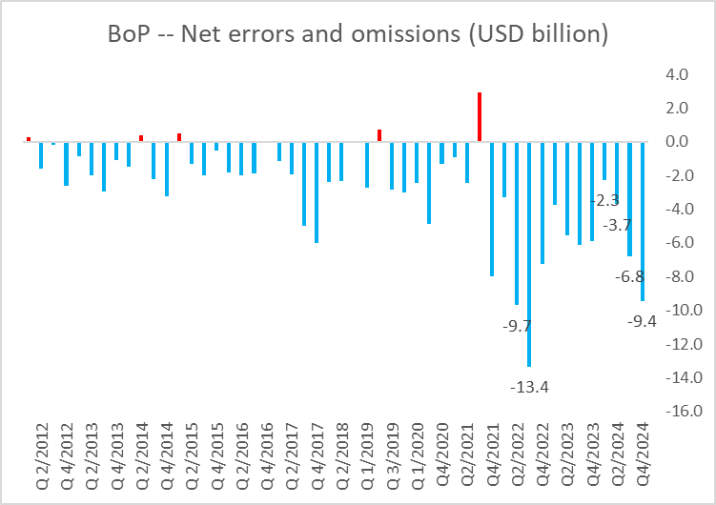
Capital flight: Going for gold?
Net errors and omissions outflows reached US$29mn in 2024, c.6% of GDP (which may be the world’s highest).
The Vietnam physical gold premium has soared again, surpassing 10% on April 16 and not looking back
Source: FIINProX, Bloomberg, Yuanta Vietnam.

